Slide 1


Slide 2
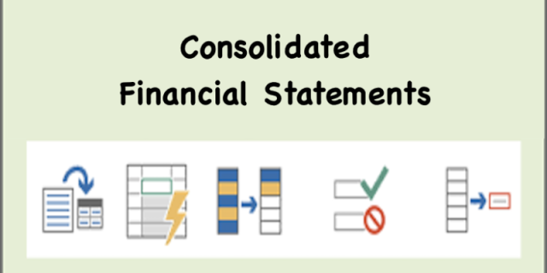
Lecture 11
Consolidated Simple Financial Statements

Slide 3
Learning Outcomes:
Upon successful completion of the session, students will be able to…
Define and describe group accounting terms such as parent, subsidiary, consolidated or group statements, etc.
Identify subsidiaries within a group structure;
Prepare a consolidated Financial Statements;
Define and identify an associate and significant influence;
Identify the situations where significant influence or participating interest exists.

Slide 4
Group and Consolidation
Consolidation means presenting the results, assets and liabilities of a group of companies as if they were one company.
You will probably know that many large companies actually consist of several companies controlled by one central or administrative company. Together, these companies are called a group

Slide 5
How does a group arise?
The central company, called a parent, generally owns most or all of the shares in the other companies, which are called subsidiaries (A subsidiary is an entity controlled by another entity).
The parent company usually controls the subsidiary by owning most of the shares in that company, but share ownership is not always the same as control, which can arise in other ways.
Example: Pizza Hut, Taco Bell & KFC –subsidiaries, Yum! Brand Inc. – parent company of these subsidiaries

Slide 6
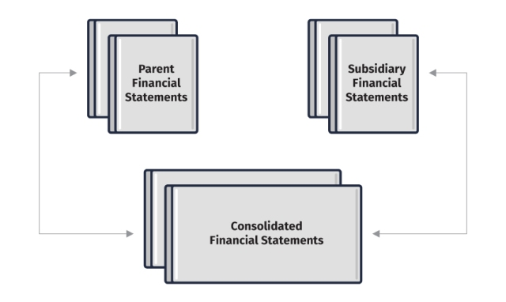

Slide 7
What does consolidation involve?
Consolidation means adding together.
Consolidation means cancellation of like items internal to the group.
Consolidate as if you owned everything then show the extent to which you do not own everything.

Slide 8
Relevant IFRS for Consolidation
IAS 27 Separate financial statements
IAS 28 Investments in associates and joint ventures
IFRS 3 Business combinations
IFRS 10 Consolidated financial statements

Slide 9
Accounting Treatment of Subsidiaries
IFRS 10 requires a parent to present consolidated financial statements (also referred to as group accounts) (IFRS 10: para 19) in which the accounts of the parent and subsidiary (or subsidiaries) are combined and presented as a single entity.
Consolidated financial statements ignore the legal boundaries of the separate legal entities. They are important because the users of the parent's financial statements need to know about the financial position, results of operations and changes in financial position of the group as a whole.
IFRS 10 requires that, when a parent issues consolidated financial statements, it should consolidate all subsidiaries, both foreign and domestic.

Slide 10
Practice
Micro Co has 100,000 shares of $1 each. On 1 January 2020, Macro Co acquired 45,000 of these shares. In addition, Macro Co is able to appoint 4 out of the 5 directors of Micro Co, thus exercising control over their activities.
Question: How should Micro Co be treated in the consolidated financial statements of Macro Co?

Slide 11
Answer
Macro holds less than 50% of the ordinary shares of Micro. Nevertheless, Micro is a subsidiary of Macro because its status is determined by a number of factors other than percentage of shares held. The key point is control rather than share ownership.
Socket will be treated as a subsidiary if any of the following apply.
(a) It holds more than half the voting power.
(b) It has power over more than half the voting rights by virtue of an agreement with other investors.
(c) It has power to govern the financial and operating policies of the entity under a statute or agreement.
(d) It has power to appoint or remove the majority of the members of the board of directors.
(e) It has power to cast the majority of votes at meetings of the board of directors.

Slide 12
Associates
An associate is an entity over which another entity exerts significant influence. Associates are accounted for in the consolidated statements of a group using the equity method.
The key criterion here is significant influence. This is the 'power to participate in the financial and operating policy decisions of the investee but which is not control or joint control of those policies.‘ (IAS 28)

Slide 13
Existence of significant influence
Representation on the board of directors (or equivalent) of the investee
Participation in the policy making process
Material transactions between investor and investee
Interchange of management personnel
Provision of essential technical information

Slide 14
Equity Accounting
IAS 28 requires the use of the equity method of accounting (or 'equity accounting') for investments in associates (IAS 28: para 16)

Slide 15
Equity Accounting
Consolidated Income Statement:
The basic principle of equity accounting is that the investing company (P Co) should take account of its share of the earnings of the associate, A Co, whether or not A Co distributes the earnings as dividends.
P Co achieves this by adding to consolidated profit the group's share of A Co's profit after tax.

Slide 16
Equity Accounting
Consolidated statement of financial position
A figure for investment in associates is shown in the consolidated statement of financial position which must be stated at cost at the time of the acquisition of the associate. This amount will increase (or decrease) each year by the amount of the group's share of the associated company's increase (or decrease) in post-acquisition retained reserves.

Slide 17
Equity Accounting
Question: Santo Co acquires 25,000 of the 100,000 $1 ordinary shares in Piston Co for $60,000 on 1 January 2020. In the year to 31 December 2020, Piston Co earns profits after tax of $24,000, from which it pays a dividend of $6,000.
How will Piston Co's results be accounted for in the individual and consolidated accounts of Santo Co for the year ended 31 December 20X9?

Slide 18
Solution:
For the year ended 31 December 20X9, Santo Co will:
DEBIT Cash $1,500
CREDIT Dividends received (6,000 × 25%) $1,500
The consolidated statement of financial position will include the asset 'Investment in associate', calculated as follows.
$
Cost of investment in associate 60,000
Share of A's profit for the year 6,000
Less dividend received (1,500)
Investment in associate 64,500

Slide 19
Solution:
In the following year, the share of Piston's profit is $6,500 and no dividend is received. The figure for 'Investment in associate' in the consolidated financial statements will be calculated as follows.
$
Investment in associate b/f 64,500
Share of A's profit for the year 6,500
Investment in associate c/f 71,000

Slide 20
Trade Investments
A trade investment is a simple investment in the shares of another entity, that is held for the accretion of wealth, and is not an associate or a subsidiary.
Trade investments are simply shown as investments under non-current assets in the consolidated statement of financial position of the group.

Slide 21
Content of Consolidated FS
Most parent companies present their own individual accounts and their group accounts in a single package. The package typically comprises the following.
Parent company financial statements, which will include 'investments in subsidiary undertakings‘ as an asset in the statement of financial position, and income from subsidiaries (dividends) in the statement of profit or loss
Consolidated statement of financial position
Consolidated statement of profit or loss and other comprehensive income (the other comprehensive income element of consolidated financial statements is beyond the scope of the
FA syllabus)
Consolidated statement of cash flows (this is beyond the scope of the FA syllabus)

Slide 22
Basic Consolidation Procedure
Take the individual accounts of the parent company and each subsidiary and cancel out items which appear as an asset in one company and a liability in another.
Add together all the uncancelled assets and liabilities throughout the group on a line by line basis.
Items requiring cancellation may include the following.
The asset 'investment in subsidiary companies' which appears in the parent company's accounts will be matched with the liability 'share capital' in the subsidiaries' accounts.
There may be intra-group trading within the group. For example, Subsidiary Co may sell goods on credit to Parent Co. Parent Co would then be a receivable in the accounts of Subsidiary Co, while
Subsidiary Co would be a payable in the accounts of Parent Co.

Slide 23
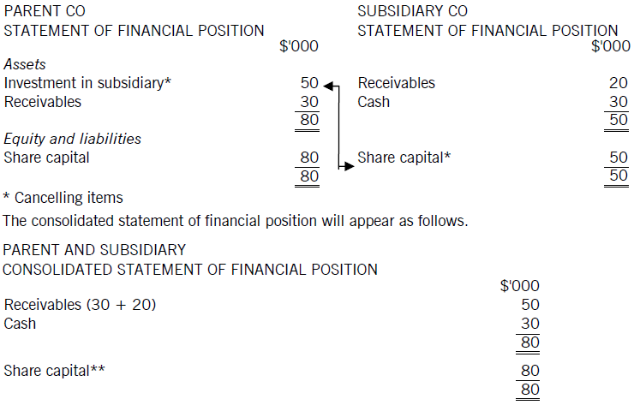
Cancellation
Parent Co has just bought 100% of the shares of Subsidiary Co. Below are the statements of financial position of both companies just before consolidation.

Slide 24
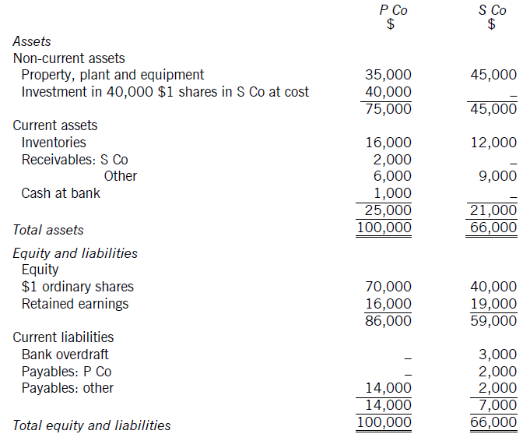
Cancellation with intra-group trading
P Co regularly sells goods to its one subsidiary company, S Co. The statements of financial position of the two companies on 31 December 20X9 are given below.

Slide 25
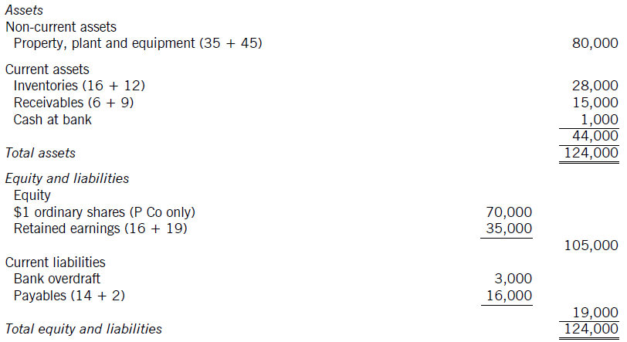
The cancelling items are as follows:
P Co's asset 'investment in shares of S Co' ($40,000) cancels with S Co's liability 'share capital‘ ($40,000).
(b) P Co's asset 'receivables: S Co' ($2,000) cancels with S Co's liability 'payables: P Co' ($2,000).
The remaining assets and liabilities are added together to produce the following consolidated statement of financial position.

Slide 26
Part cancellation
An item may appear in the statements of financial position of a parent company and its subsidiary, but not at the same amounts.
The parent company may have acquired shares in the subsidiary at a price greater or less than their face (or 'par') value. The asset will appear in the parent company's accounts at cost, while the equity will appear in the subsidiary's accounts at par value. This raises the issue of goodwill.
Even if the parent company acquired shares at par value, it may not have acquired all the shares of the subsidiary (so the subsidiary may be only partly owned). This raises the issue of non-controlling interests.

Slide 27
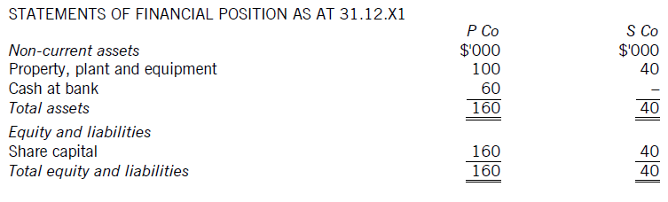
Goodwill arising on consolidation
Goodwill arising on consolidation is recognized as an intangible asset in the consolidated statement of financial position (IFRS 3: para 32).
Example: P Co purchased all of the share capital (40,000 $1 shares) of S Co for $60,000 in cash. The statements of financial position of P Co and S Co prior to the acquisition are as follows.

Slide 28
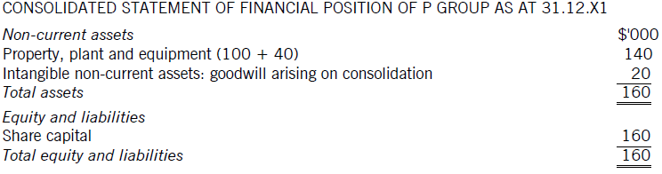
Goodwill arising on consolidation
The entries in P Co's books would be:
DEBIT Investment in S Co $60,000
CREDIT Bank $60,000
So P Co's individual statement of financial position will look as follows.
Non-current assets $'000 Equity and liabilities
Property, plant and equipment 100 Share capital 160
Investment in S Co 60 Total equity and liabilities 160
Total assets 160

Slide 29
Goodwill and pre-acquisition profits
Any pre-acquisition retained earnings of a subsidiary company are not aggregated with the parent company's retained earnings in the consolidated statement of financial position.
The figure of consolidated retained earnings comprises the retained earnings of the parent company plus the post-acquisition retained earnings only of subsidiary companies. The post-acquisition retained earnings are simply retained earnings now less retained earnings at acquisition.

Slide 30
Fair value of net assets at acquisition
The land and buildings of the subsidiary may be worth more than their carrying amount at acquisition. If this is the case, it must be taken into account in the consolidated financial statements, as follows.
The subsidiary's land and buildings must be included in the consolidated statement of financial position at their fair value.
The difference between the fair value of the subsidiary's land and buildings and the carrying value of those land and buildings must be taken into account in the goodwill calculation. This is known as a fair value adjustment.

Slide 31
Fair value of net assets at acquisition
The proforma for goodwill will now look as follows.
Goodwill $ $
Consideration transferred X
Less net acquisition-date fair value of identifiable
assets acquired and liabilities assumed:
Ordinary share capital X
Share premium X
Retained earnings at acquisition X
Fair value adjustments at acquisition X
(X)
Goodwill X

Slide 32
Non-controlling Interests (NCI)
The non-controlling interest (NCI) shows the extent to which net assets controlled by the group are owned by other parties.
IFRS 10 defines non-controlling interest as the 'equity in a subsidiary not attributable, directly or indirectly, to a parent'.

Slide 33
Non-controlling Interests (NCI)
NCI is shown in the equity section of the consolidated statement of financial position (IFRS 10: para 22) & is included in the consolidated financial statements at its fair value plus the NCI's share of post acquisition retained earnings and other reserves.
Non-controlling interest $
Fair value of NCI at acquisition X
Plus NCI's share of post-acquisition retained earnings
(and other reserves) X
NCI at reporting date X

Slide 34
NCI & Group retained earnings
Retained earnings P Co S Co
$ $
Per question X X
Pre-acquisition retained earnings (X)
Y
Group share of post-acquisition retained
earnings:
S Co (Y × %) X
Group retained earnings X

Slide 35
Goodwill & NCIs
Goodwill $ $
Fair value of consideration transferred X
Plus fair value of NCI at acquisition X
Less net acquisition-date fair value of identifiable assets acquired and liabilities assumed:
Ordinary share capital X
Share premium X
Retained earnings at acquisition X
Fair value adjustments at acquisition X
(X)
Goodwill X

Slide 36
Goodwill attributable to NCI
Total goodwill is recognized in the statement of financial position, as the group controls 100% of it.
However, we can calculate goodwill attributable
to the NCI as follows.
$'000
Fair value of NCI 1,000
NCI in net assets at acquisition (10%*8,000) (800)
Goodwill 200

Slide 37
Intra-group trading and unrealized profits
Suppose that a holding company P Co buys goods for $1,600 and sells them to a wholly owned subsidiary S Co for $2,000. The goods are all still in S Co's inventory at the year end and appear in S Co's statement of financial position at $2,000. In this case, P Co will record a profit of $400 in its individual accounts, but from the group's point of view the figures are:
Cost $1,600
External sales nil
Closing inventory at cost $1,600
Profit/loss nil

Slide 38
Provision for unrealized profit
A consolidation adjustment is therefore necessary as follows.
DEBIT Group reserves
CREDIT Group inventory (statement of financial position)
If we add together the figures for retained reserves and inventory in the individual statements of financial position of P Co and S Co, the resulting figures for consolidated reserves and consolidated inventory will each be overstated by $400.

Slide 39
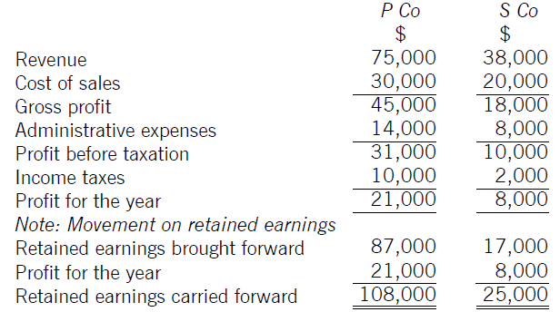
Consolidated Income Statement
The consolidated statement of profit or loss is prepared by combining the statements of profit or loss of each group company on a line by line basis.
Example: P Co acquired 75% of the ordinary shares of S Co on that company's incorporation in 20X6. The summarised statements of profit or loss of the two companies for the year ending 31 December 20X9 are set out below.

Slide 40
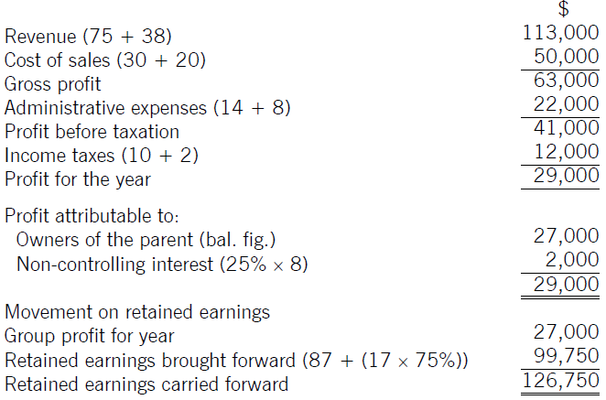
Consolidated Income Statement
Consolidated Income Statement for the year ended 31December 2019

Slide 41
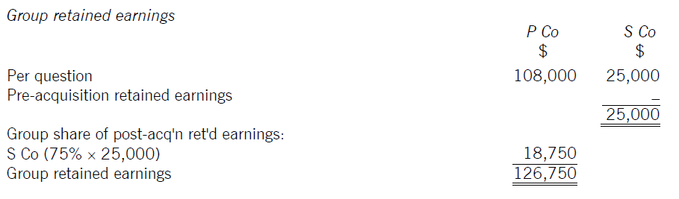
Working for group retained earnings
Notice that a consolidated statement of profit or loss links up with a consolidated statement of financial position exactly as in the case of an individual company's accounts.

Slide 42
Intra-group Trading
Intra-group sales and purchases are eliminated from the consolidated statement of profit or loss (IFRS 10: para B86(c))
The best way to deal with this for the consolidated statement of profit or loss is to calculate the unrealized profit on unsold inventories at the year end and reduce consolidated gross profit by this amount. Cost of sales will be the balancing figure.

Slide 43
Intra-group Trading
Pumpkin has held 90% of the equity share capital of Squash for many years. Cost of sales for each entity
for the year ended 31 December 20X9 was as follows.
$
Pumpkin 100,000
Squash 80,000
During the year, Squash sold goods costing $5,000 to Pumpkin for $8,000. At the year end, all these goods remained in inventory.
What figure should be shown as cost of sales in the consolidated statement of profit or loss of the Pumpkin group for the year ended 31 December 20X9?
If Squash's profit for the year was $16,000, what is the profit attributable to the NCI?

Slide 44
Solution: Intra-group Trading
Pumpkin 100,000
Squash 80,000
180,000
Less intra-group sales (8,000)
Add unrealized profit 3,000
175,000
b) Profit attributable to the NCI = (16,000 – 3,000 unrealized profit) * 10% = $1,300

Slide 45
Lecture Roundup:
Consolidated financial statements present the results of the group; they do not replace the separate financial statements of the individual group companies.
Basic consolidation consists of two procedures.
- Cancelling out items which appear as an asset in one company and a liability in another
- Then adding together all the uncancelled assets and liabilities on a line by line basis.
3. The consolidated statement of profit or loss is prepared by combining the statements of profit or loss of each group company on a line by line basis

Slide 46
Reference
ACCA (2017) Approved Interactive Text. Foundations in Accountancy FFA 2017/2018. BPP Media Ltd, Chapter 23, 24 & 25

